Slide 1

Customer Shopping Behavior Analysis
Executive summary of revenue drivers, customer loyalty, and strategic opportunities

Slide 2
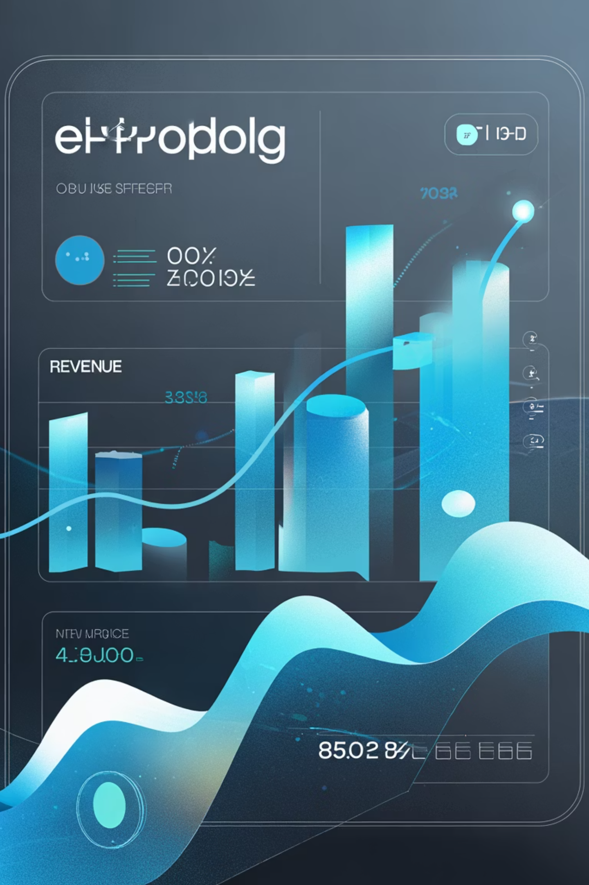
Revenue Overview: $233K from 3,900 Purchases
$233K
3,900
3.75
Total Revenue
Total Purchases
Avg Rating
Generated across customer base
Strong transaction volume
Out of 5.0 stars
80%
Loyal Customers
High retention rate

Slide 3
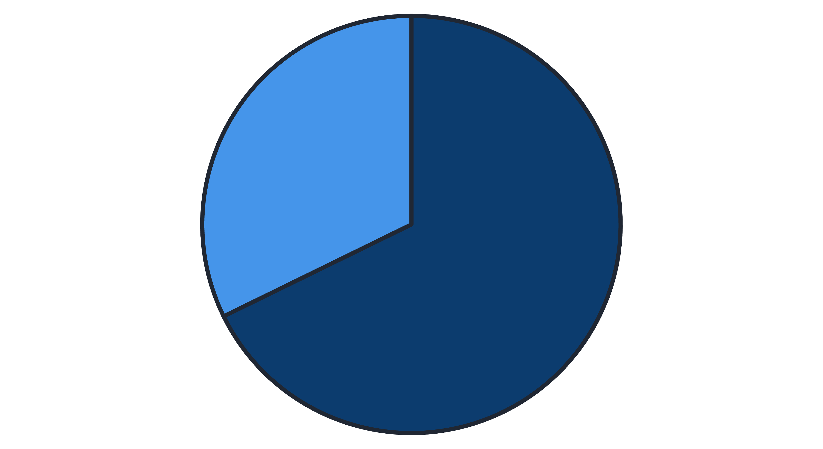
Male Customers Drive 68% of Revenue
Significant gender-based purchasing disparity reveals key segmentation opportunity
Male
Female
Strategic imperative: Develop targeted product assortments and gender-specific marketing campaigns to capture untapped female customer potential

Slide 4
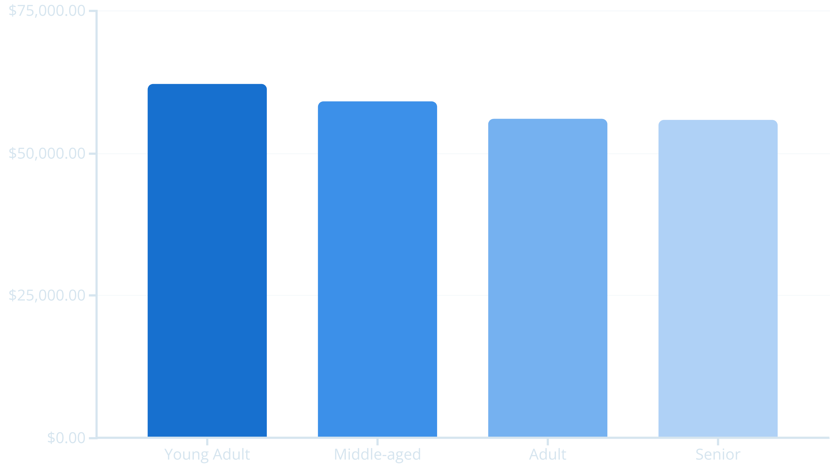
Age Drives Revenue Distribution
Young adults lead revenue generation with strongest purchasing power
Marketing focus: Youth-oriented social media campaigns and influencer partnerships show highest ROI potential

Slide 5


Loyalty Gap: 80% Loyal but Only 27% Subscribed
Massive untapped opportunity to convert loyal customers into subscription revenue
Conversion Opportunity
2,063 loyal customers are non-subscribers. Targeted incentives and exclusive benefits can unlock significant recurring revenue
80%
Loyal Customers
3,116 in base
27%
Subscription Rate
1,053 subscribers

Slide 6

High-Value Customers: Discount-Responsive Spenders
30+ customers exceed average spending ($59+) while actively using discounts
Premium Loyalty Opportunity
Untapped Potential
Convert discount dependency into premium pricing through exclusive tiered loyalty experiences
High spenders using discounts represent ideal candidates for VIP programs and exclusive benefits
Strategic Action
Develop VIP tier offering early access, exclusive products, and premium perks to eliminate discount dependency

Slide 7
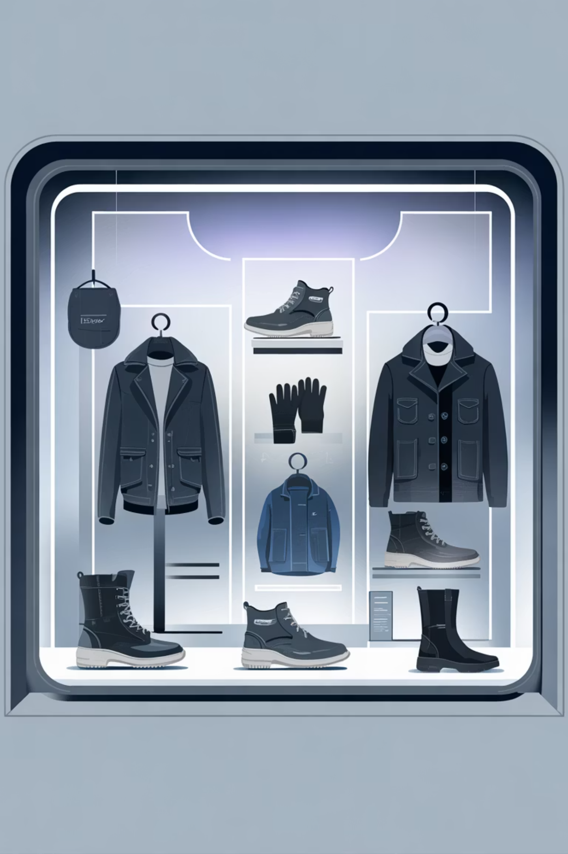
Product Performance: Quality vs. Discount Dependency
Top-rated products maintain satisfaction without heavy discounting; others rely heavily on promotions
Top-Rated Products
Discount-Dependent
Gloves (3.98⭐) - Strong satisfaction
Hat (50% discount rate) - Needs repricing
Sandals (3.94⭐) - Consistent quality
Sneakers (49.7%) - Pricing challenge
Boots (3.90⭐) - Customer favorite
Coat (49.1%) - Margin pressure

Slide 8

Strategic Roadmap: Next 90 Days
Days 1–30
Days 1–30
Male Customer Optimization: Launch gender-specific bundles and promotional campaigns to strengthen market position
Loyalty-to-Subscription Campaign: Convert 3,116 loyal non-subscribers with targeted incentives and exclusive benefits
Days 30–120
Days 30–90
Pricing Strategy Overhaul: Reduce discount dependency by 5% through strategic repricing of Hat, Sneakers, and Coat categories
Young Adult Initiative: Deploy social media campaigns and influencer partnerships targeting 18–30 demographic for 10% revenue growth

Slide 9

Unlock $100M+ in Customer Lifetime Value
Strong loyalty foundation + subscription conversion + demographic focus = Significant revenue growth without major acquisition costs
15% Subscription Increase
10% Young Adult Growth
Convert 500+ loyal customers within 60 days
Targeted campaigns reaching prime demographic in 90 days
5% Discount Efficiency
Reduce promotional dependency through strategic repricing by 120 days

